Slide 1


Text Prediction On Movie Reviews
Jason Maloney, Maya Mileva,
Antonio Llorens and Bing-Je Wu

Slide 2
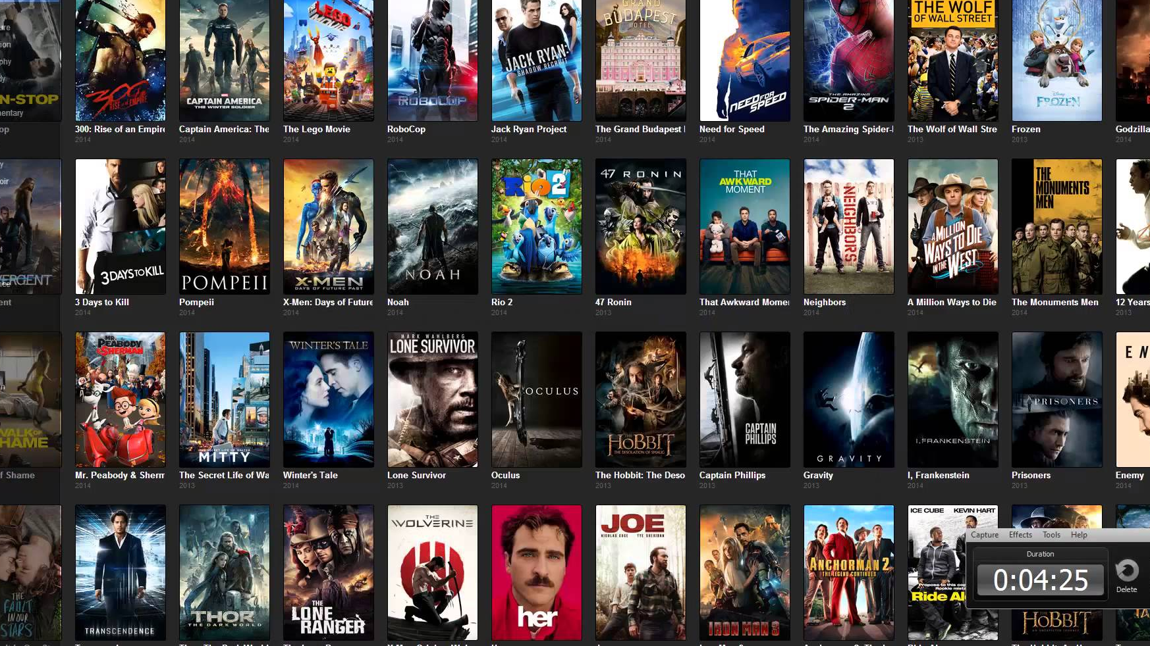
Introduction

Slide 3

- Comedies - Action - War - Fiction - Drama - Documentary

Slide 4

Why are the movie reviews important?

Slide 5
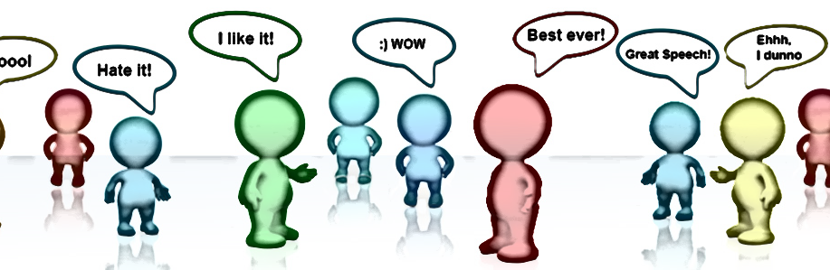
Sentiment?
Sentiment Analysis is the process of determining whether a piece of writing is positive, negative or neutral.

Slide 6
DATA
Large Movie Review Dataset

Slide 7
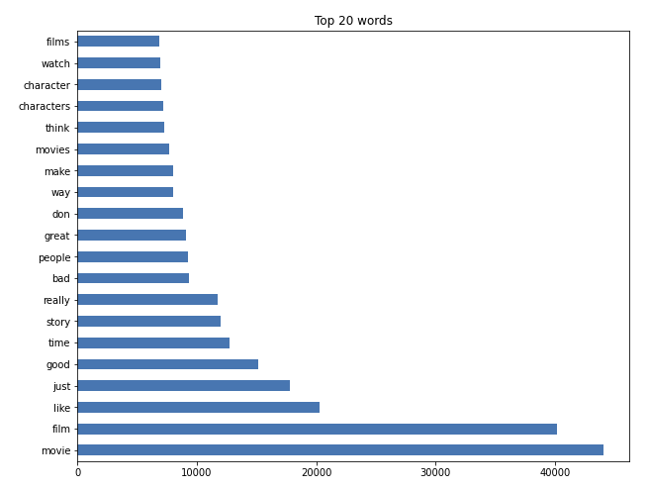
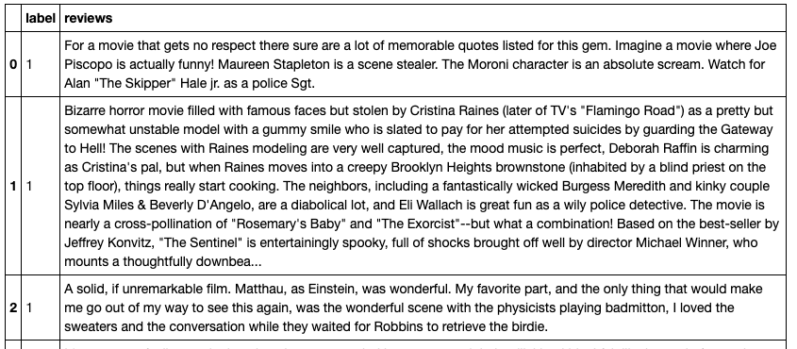
20 Most Common Words - Stop Words Filtered
50,000 labeled Movie Reviews from IMDb

Slide 8
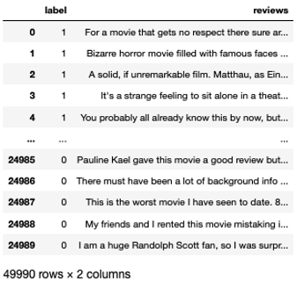
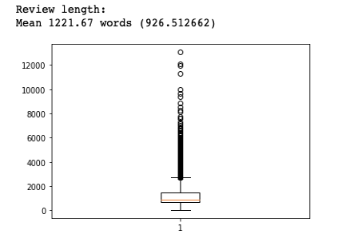
More about the data…
Data frame example structure
Average review length
POSITIVE
NEGATIVE

Slide 9
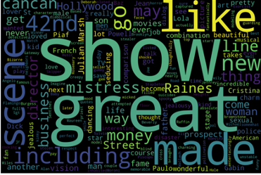
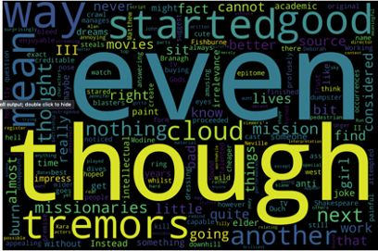
positive reviews word cloud
negative reviews word cloud

Slide 10

Sentiment Models

Slide 11
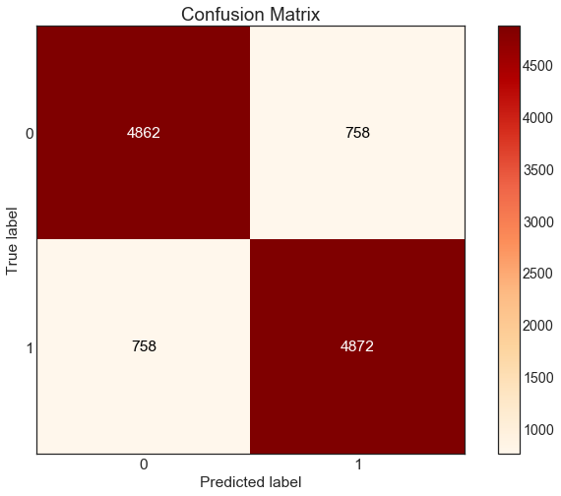
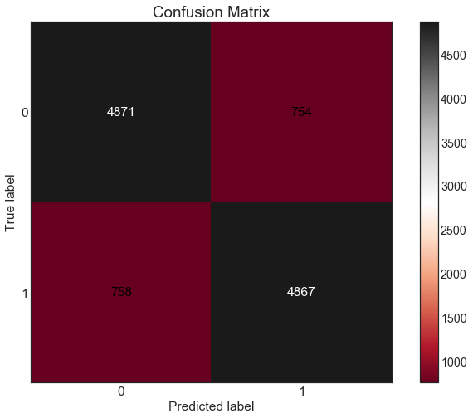
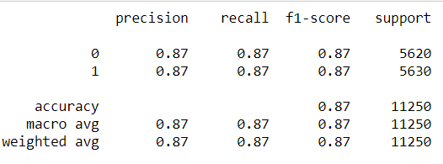
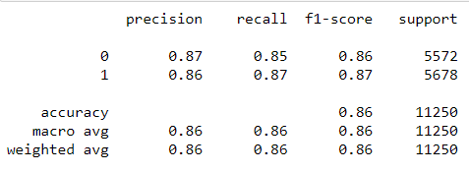
MNB 87% accuracy
- TFIDF Vectorizer
- Count Vectorizer

Slide 12
Most indicative words..
TOP NEGATIVE
TOP POSITIVE
'avoid costs' 'complete waste', 'possibly worst' 'total waste' 'worst acting' 'worst films' 'acting awful' 'acting horrible' 'avoid like' 'boll' 'horrible acting' 'save time' 'scarecrows' 'bad’ ‘half time’ | -14.171727997263718 -14.171727997263718 -14.171727997263718 -14.171727997263718 -14.171727997263718 -14.171727997263718 -13.478580816703772 -13.478580816703772 -13.478580816703772 -13.478580816703772 -13.478580816703772 -13.478580816703772 -13.478580816703772 -13.478580816703772 -13.073115708595608 -13.073115708595608
‘one’ ‘like’ ‘good’ ‘story’ ‘great’ ‘well’ ‘time’ ‘see’ ‘also’ ‘really’ ‘would’ ‘even’ ‘much’ ‘first’ ‘love’ ‘people’ ‘best’ ‘get’ ‘life’ ‘way’ | -4.5999440692737 -5.043900046861999 -5.207160294662106 -5.355171228621861 -5.358289502735211 -5.3690551569509 -5.372518755022327 -5.402065489151443 -5.529665823801611 -5.5471164090802105 -5.563963107663094 -5.660351691169044 -5.689954751078741 -5.690991342858096 -5.748406021457551 -5.774670607087462 -5.776702439821687 -5.794716836447343 -5.820589390177563 -5.832227094257773

Slide 13

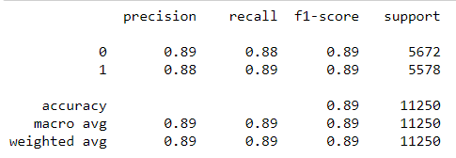
SVM 89% accuracy
C = 0.01
Count Vectorizer

Slide 14
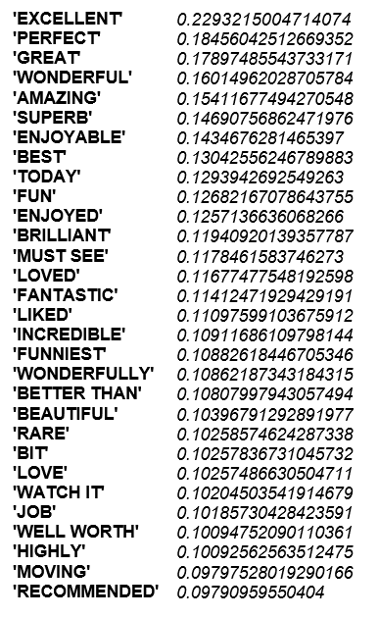
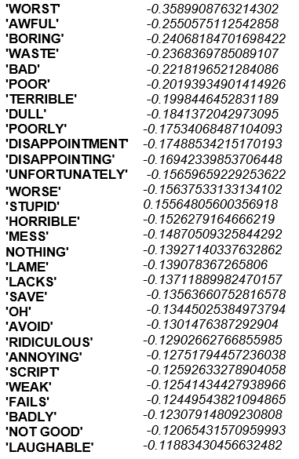
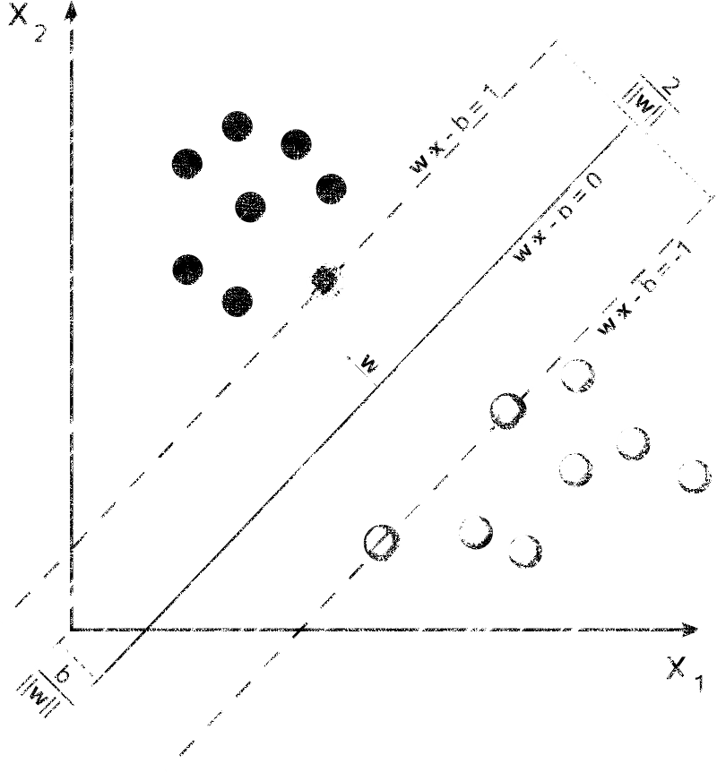
Most Indicative words…
TOP POSITIVE
TOP NEGATIVE

Slide 15
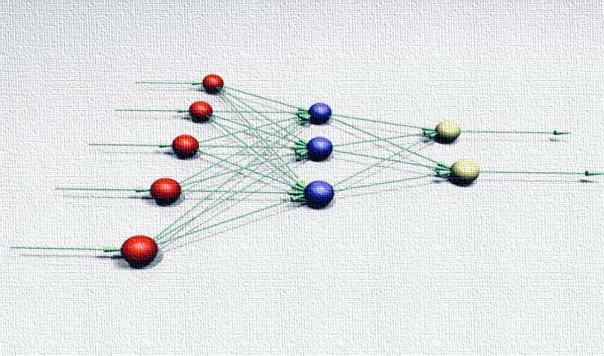
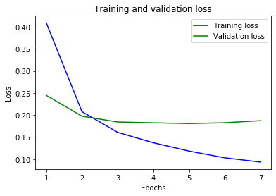
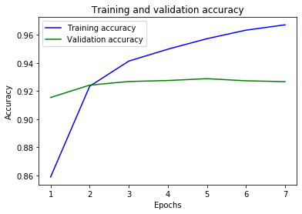
Neural Network
How many layers to use in the model?
How many hidden units to use in each layer?
Keras
93% accuracy
Activation function
Compile the model
Train the model
Evaluate the model

Slide 16
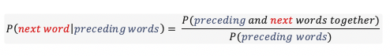
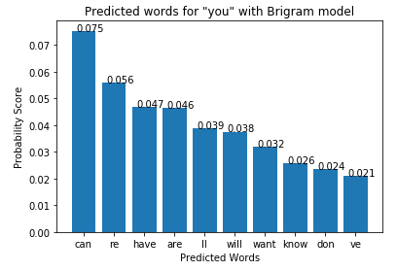
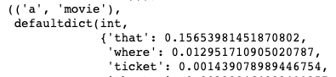
n-gram Model
Calculate Probabilities
Output Most Likely Word
Create a Dictionary

Slide 17
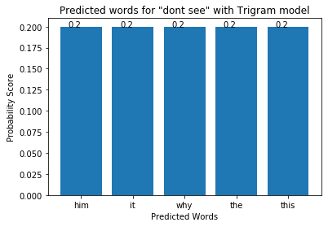
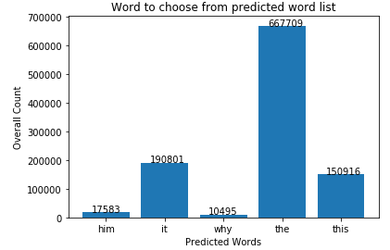
Do we always predict a word?

Slide 18
Results

Slide 19
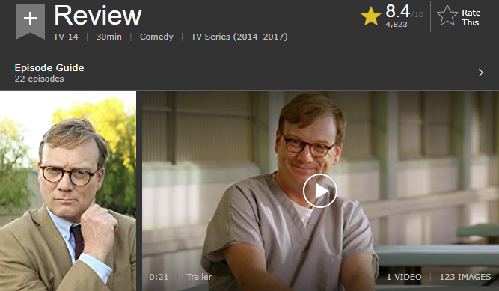
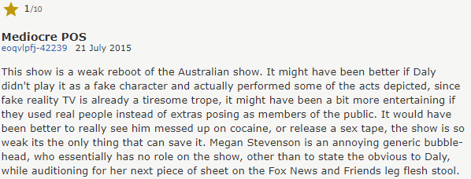
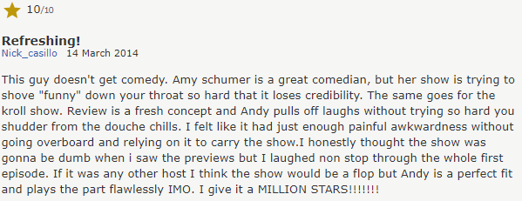
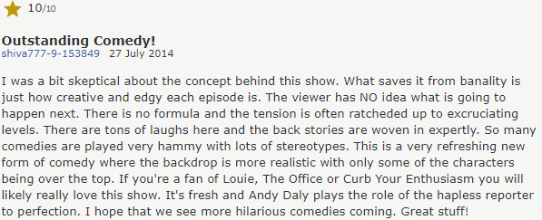

Slide 20
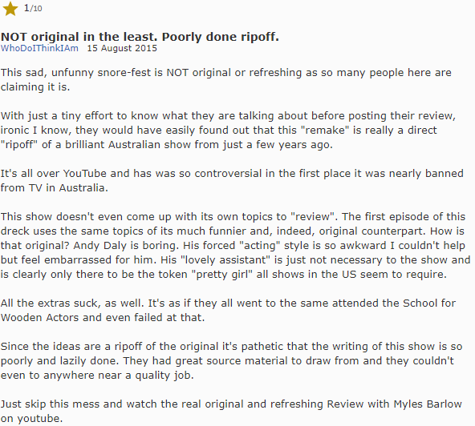
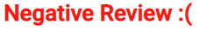
Result - Negative Review

Slide 21
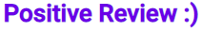
Result - Positive Review

Slide 22
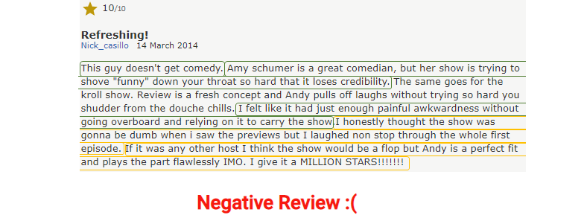
Result - False Negative

Slide 23

Language Model
Expect next word for “I like to watch harry ...”
Trigram model:
“ macy ”
Bigram model:
“ potter ”

Slide 24

Conclusion

Slide 25



Review is important
Production
Users
Streaming services/ Movie Theatre
Netflix
Hulu
Amazon Prime Video
Text Prediction can be useful
Utilizing past to predict future

Slide 26

Reference:
Large Movie Review Dataset
https://ai.stanford.edu/~amaas/data/sentiment/
GitHub:
https://github.com/bing020815/text_prediction_application
Demo:
https://pdht24snt663m2h7.anvil.app/OT4EUOR5JVBBGOHFV533U2KM

Slide 27


